Slide 1
Digital Portfolio
STUDENT NAME: PAVAN KUMAR G
REGISTER NO AND NMID: 2422K0085 AND AE4A2B96884A186897743F7805BE4A03
DEPARTMENT: COMPUTER SCIENCE
COLLEGE: KPR COLLEGE OF ARTS SCIENCE AND RESEARCH

Slide 2
PROJECT TITLE
ECOMMERCE WEBSITE

Slide 3


AGENDA
Problem Statement
Project Overview
End Users
Tools and Technologies
Portfolio design and Layout
Features and Functionality
Results and Screenshots
Conclusion
Github Link
3/21/2024 Annual Review

Slide 4

PROBLEM STATEMENT
In today’s digital world, customers increasingly prefer to shop online due to convenience and accessibility. However, many current eCommerce websites lack an intuitive, user-friendly interface, are not mobile responsive, and sometimes fail to offer a seamless experience when searching for products, browsing categories, or completing a purchase.
Our goal is to develop an eCommerce platform where users can easily browse, search, and purchase items from various categories such as electronics, fashion, and home goods. The platform will feature product filtering, secure payment gateways, a user-friendly shopping cart, and customer accounts for order tracking and personalized recommendations.

Slide 5

PROJECT OVERVIEW
Project Description:
The portfolio website is designed to be a professional online platform where individuals (such as designers, developers, freelancers, or other creatives) can showcase their work, skills, and services. This website will serve as a central hub for potential clients or employers to learn about the individual, view completed projects, and easily get in touch. The portfolio will emphasize clean design, user-centric navigation, and accessibility, ensuring it functions well on all devices (desktop, tablet, mobile).
Project Purpose:
The purpose of the portfolio website is to:
Showcase Work: Display the individual’s best work with clear descriptions, images, and links to live projects or repositories.
Demonstrate Skills and Expertise: Clearly communicate the individual’s skills and the services they offer.
Enhance Professional Image: Provide a polished, professional image that can be shared with potential clients, collaborators, or employers.
Improve Online Presence: Increase the individual’s online visibility and search engine presence for better opportunities.

Slide 6

WHO ARE THE END USERS?
The end users of the eCommerce website are individuals looking to shop online for various products, ranging from electronics to fashion and home goods. They are tech-savvy, value convenience, and expect an easy-to-navigate platform that offers a seamless shopping experience.
Characteristics of End Users:
Shoppers of Various Demographics:
Age: 18 to 65+
Tech-savvy individuals comfortable with browsing online and making digital payments.
Individuals seeking a hassle-free shopping experience.
First-time Shoppers and Returning Customers:
First-time users: Seeking an easy introduction to the website with simple navigation and a fast sign-up process.
Returning users: Expect personalized recommendations, easy access to their order history, and a quicker checkout process.

Slide 7

TOOLS AND TECHNIQUES
HTML/CSS/JavaScript:
Purpose: Building the structure, design, and interactive elements of the website.
Front-End Frameworks:
React.js or Vue.js:
Purpose: Build dynamic and fast single-page applications (SPAs) for a seamless user experience
Server-Side Languages:
Node.js with Express.js:
Purpose: Handling the server-side logic, API creation, and managing the database.
PHP with Laravel (if preferred):
Purpose: Building the backend architecture with a focus on MVC (Model-View-Controller)

Slide 8
POTFOLIO DESIGN AND LAYOUT
Project Grid: Display your work in grid format, with clickable cards for each project.
Filter Projects: Provide category filters (e.g., Web Development, UI/UX Design) to help users find relevant projects.
Project Details Modal/Page: When clicked, each project should display:
Project Description: Short overview of the project.
Technologies Used: Icons or text (e.g., React, Node.js)
Project Links: Links to the live project or GitHub repository.
Contact Section
Contact Form: Include fields like Name, Email, Subject, and Message.
Social Media Links: Icons linked to your LinkedIn, GitHub, Twitter, etc.
Google Map: Optionally, display your location if relevant.
Contact Info: Email and phone number for direct contact.
8

Slide 9
FEATURES AND FUNCTIONALITY
To provide features and functionality for the portfolio design project, I'll list some key aspects based on general expectations for portfolio websites. Let me know if you want to customize it according to specific needs or based on the image you uploaded.
Hero Section:
Personal Introduction: Display a brief intro (name, profession, skills).
Call to Action (CTA): A button like "View My Work" or "Contact Me" to guide users to other sections.
Background Image/Video: A clean, modern background showcasing a personal image or related professional work.
Services Section:
List of Services: Clearly define the services you offer (e.g., web development, graphic design, UI/UX design).
Brief Description: Each service can include a short explanation of what the service entails.
Pricing or Contact CTA: An optional feature to include basic pricing or a "Get in Touch" button.

Slide 10
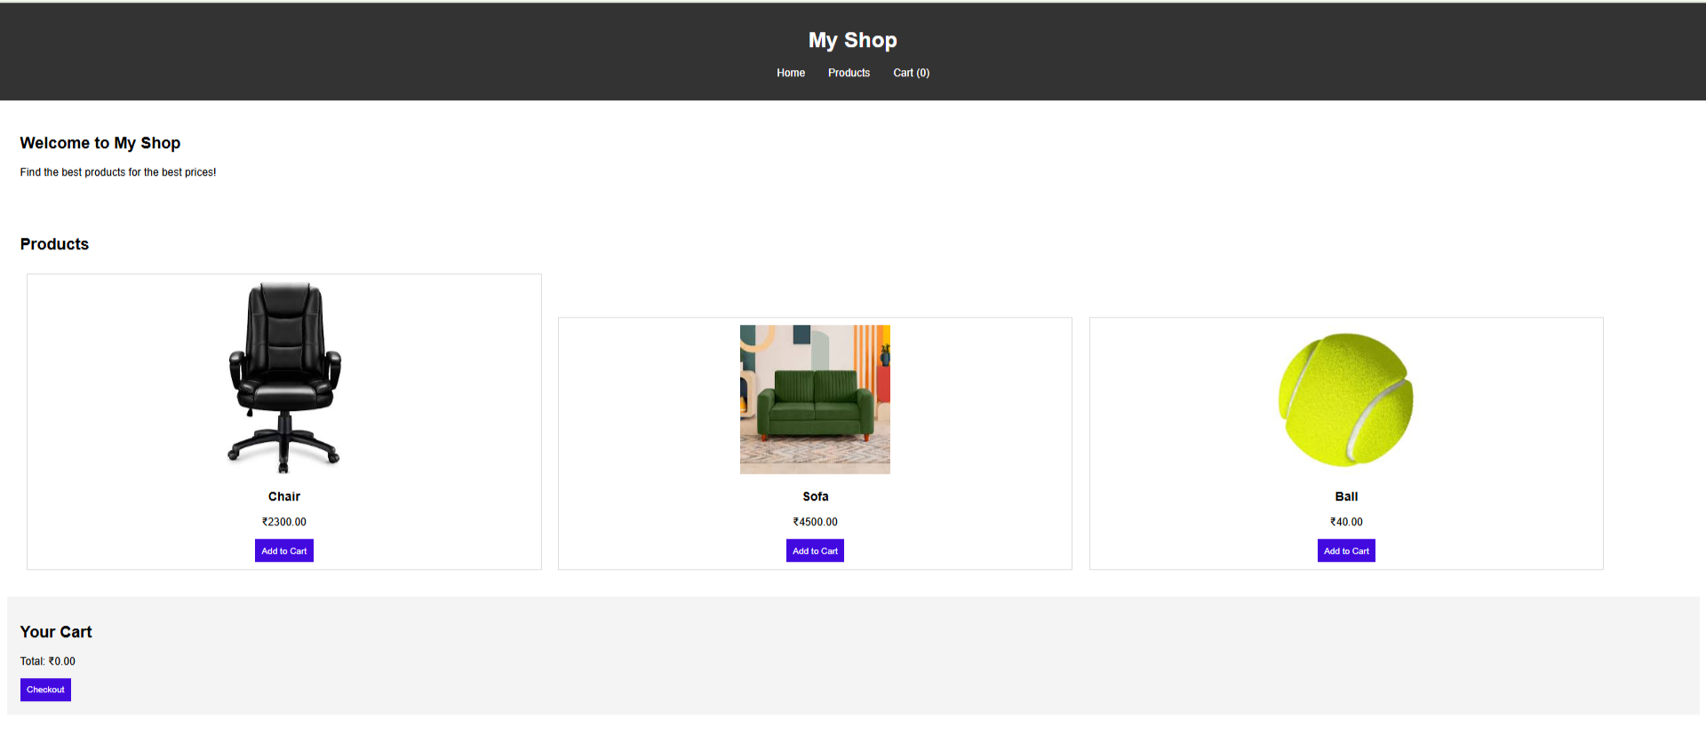

RESULTS AND SCREENSHOTS
3/21/2024 Annual Review
10

Slide 11
CONCLUSION
In conclusion, a well-designed and functional portfolio website serves as an essential tool for showcasing your skills, projects, and services to potential clients or employers. By incorporating a user-friendly interface, clear navigation, and engaging visuals, you can create a memorable online presence that highlights your expertise.
Key elements like a dynamic portfolio section, a personalized about me area, and an intuitive contact form will ensure that visitors can easily understand your work and get in touch. Additionally, features like responsive design, SEO optimization, and smooth animations will enhance the overall user experience, making your portfolio accessible and engaging across all devices.
Whether you are a developer, designer, or freelancer, the ability to display your work professionally and efficiently can help you stand out in a competitive market. Implementing these features and functionalities will not only improve the aesthetics of your site but also provide seamless usability, ultimately helping you reach your goals and attract more opportunities.
11

